Slide 1
4DEVBANK
/4DEVBANK
Projeto de SPA trade4Dev
trade4Dev.jsx

Slide 2



/DEVS
Emanoel Evaristo
Felippe Araujo
4DEVBANK
e-evaristo
felippecsba
trade4Dev.jsx

Slide 3
/PROJETO
Telas:
Tecnologias
4DEVBANK
Tela de Login
Tela de OnBoard
Saldo
Extrato
Operações
Cadastro de Contas
HTML
CSS
ReactJS
React Router DOM
Axios (consumo de APIs)
Site
Projeto (Github)
trade4Dev.jsx

Slide 4
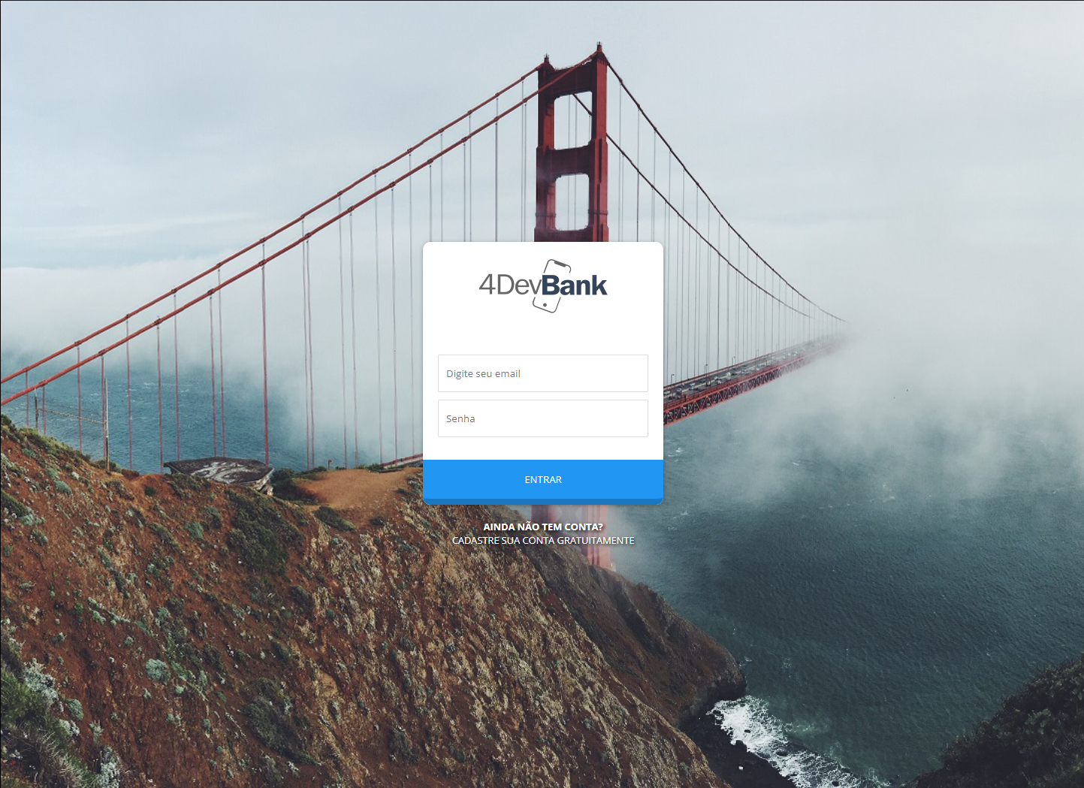
/LOGIN
4DEVBANK
trade4Dev.jsx

Slide 5
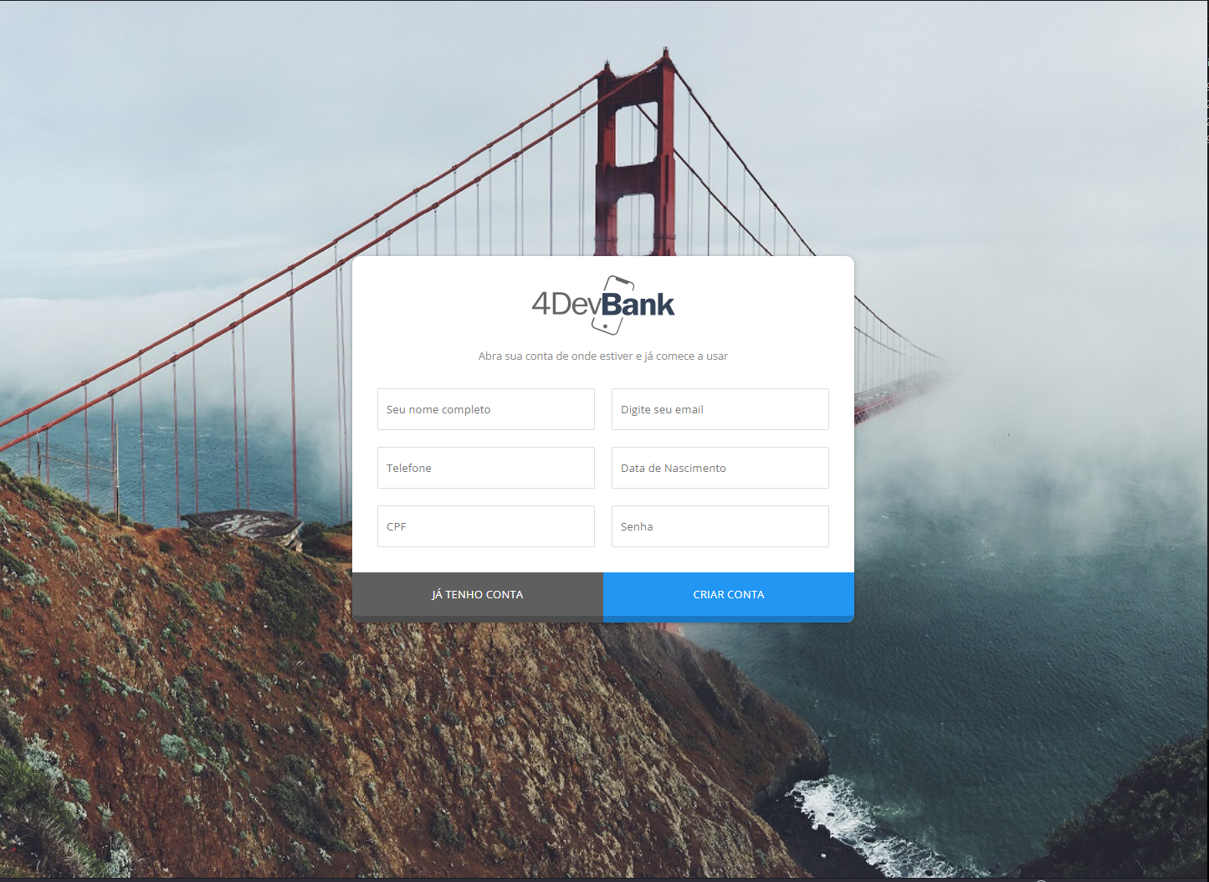
/CADASTRO
4DEVBANK
trade4Dev.jsx

Slide 6
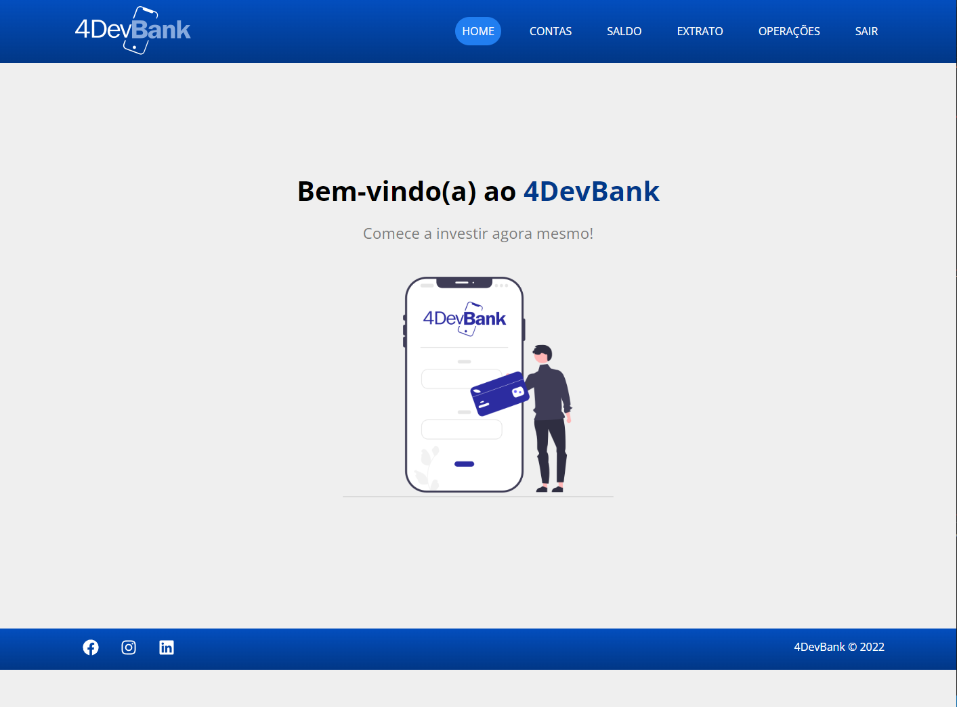
/HOME
4DEVBANK
trade4Dev.jsx

Slide 7
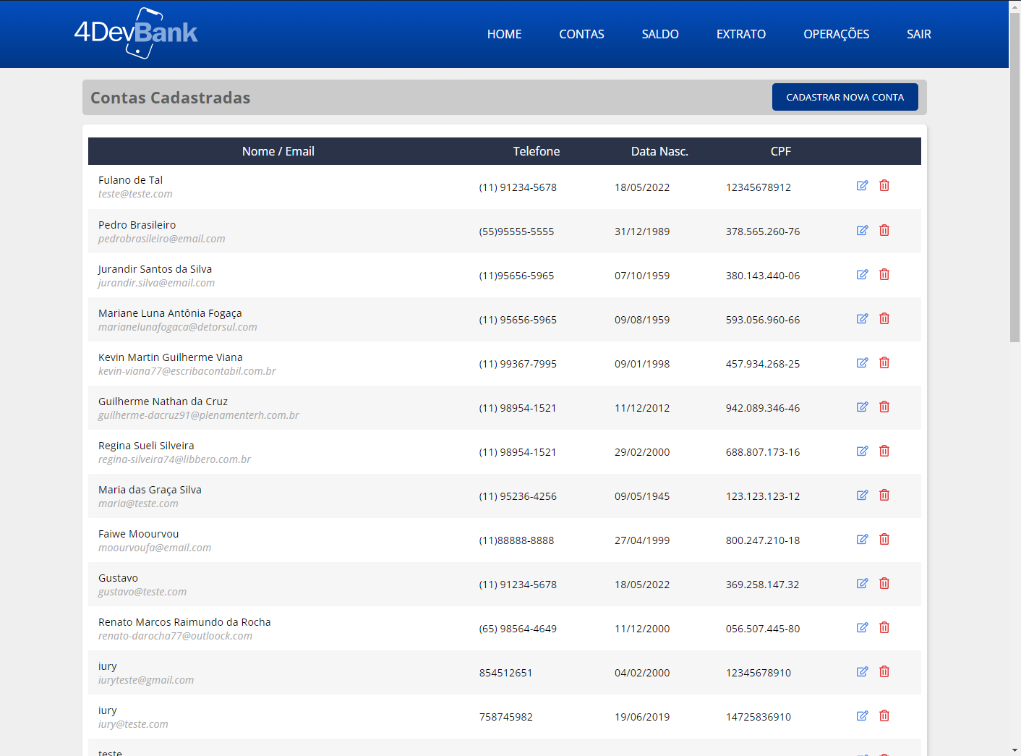
/CONTAS
4DEVBANK
trade4Dev.jsx

Slide 8
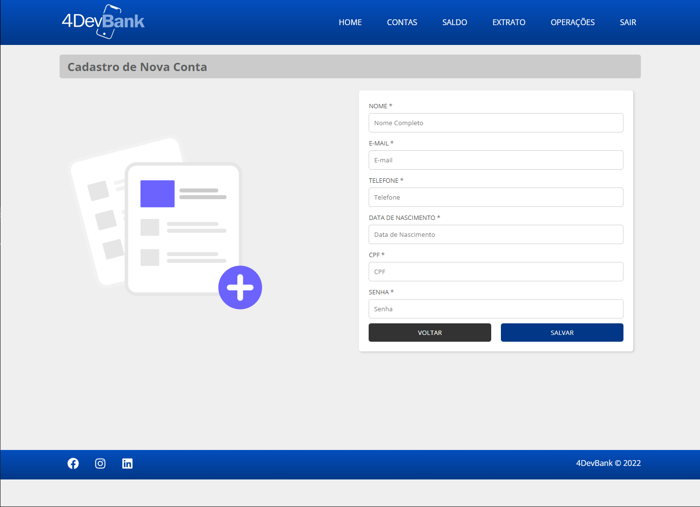
/CADASTRO
4DEVBANK
trade4Dev.jsx

Slide 9
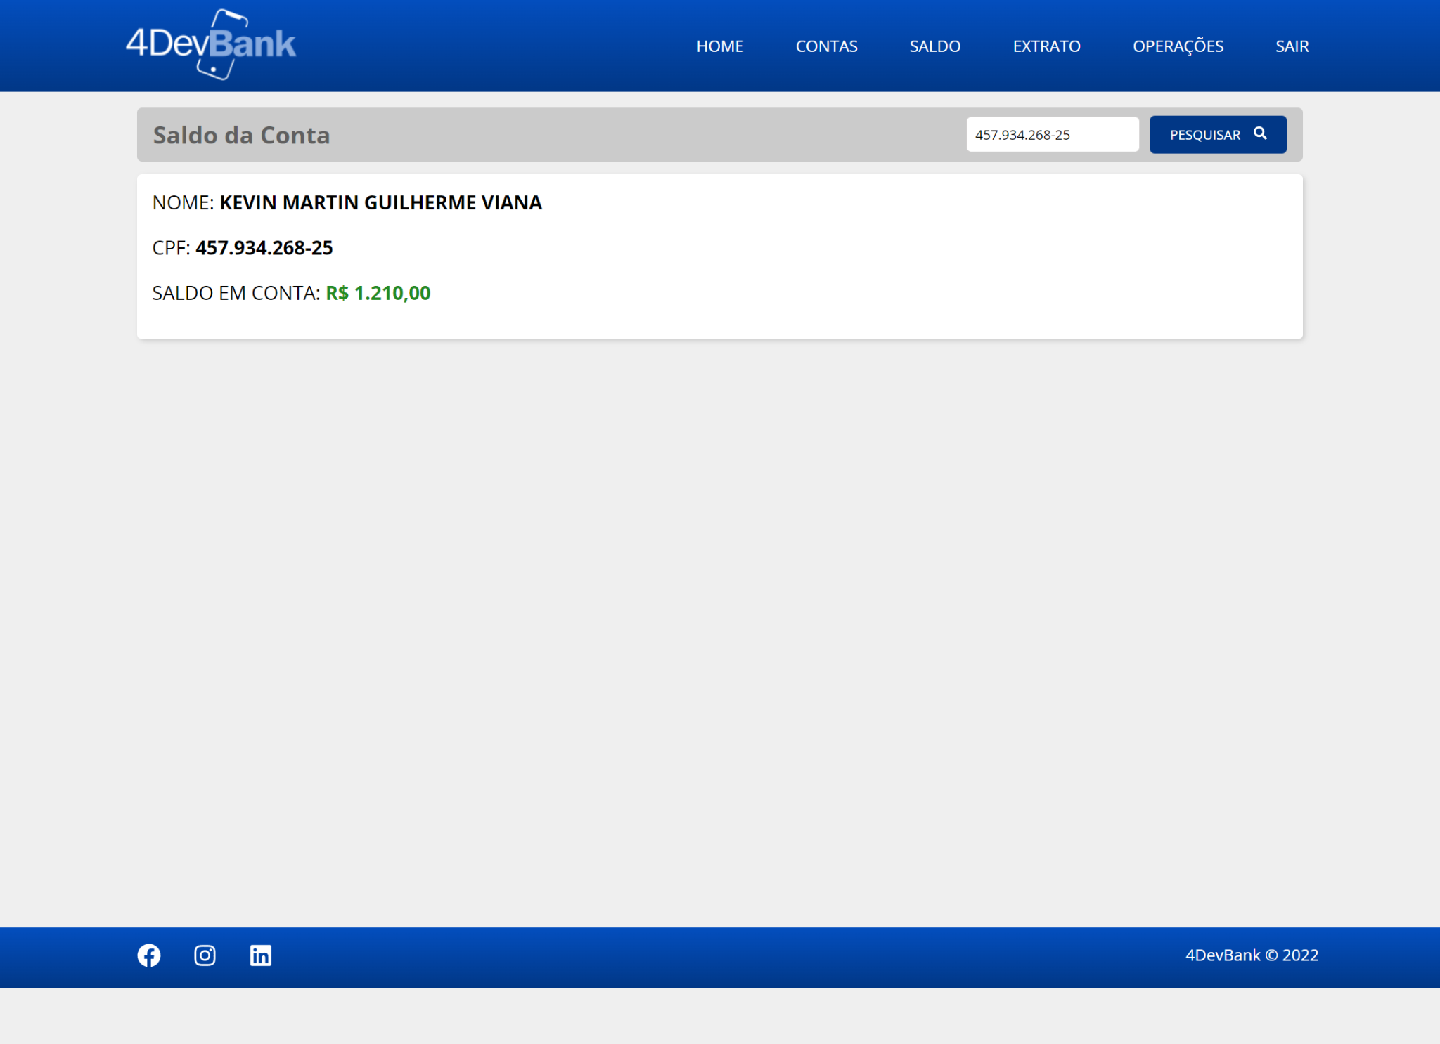
/SALDO
4DEVBANK
trade4Dev.jsx

Slide 10
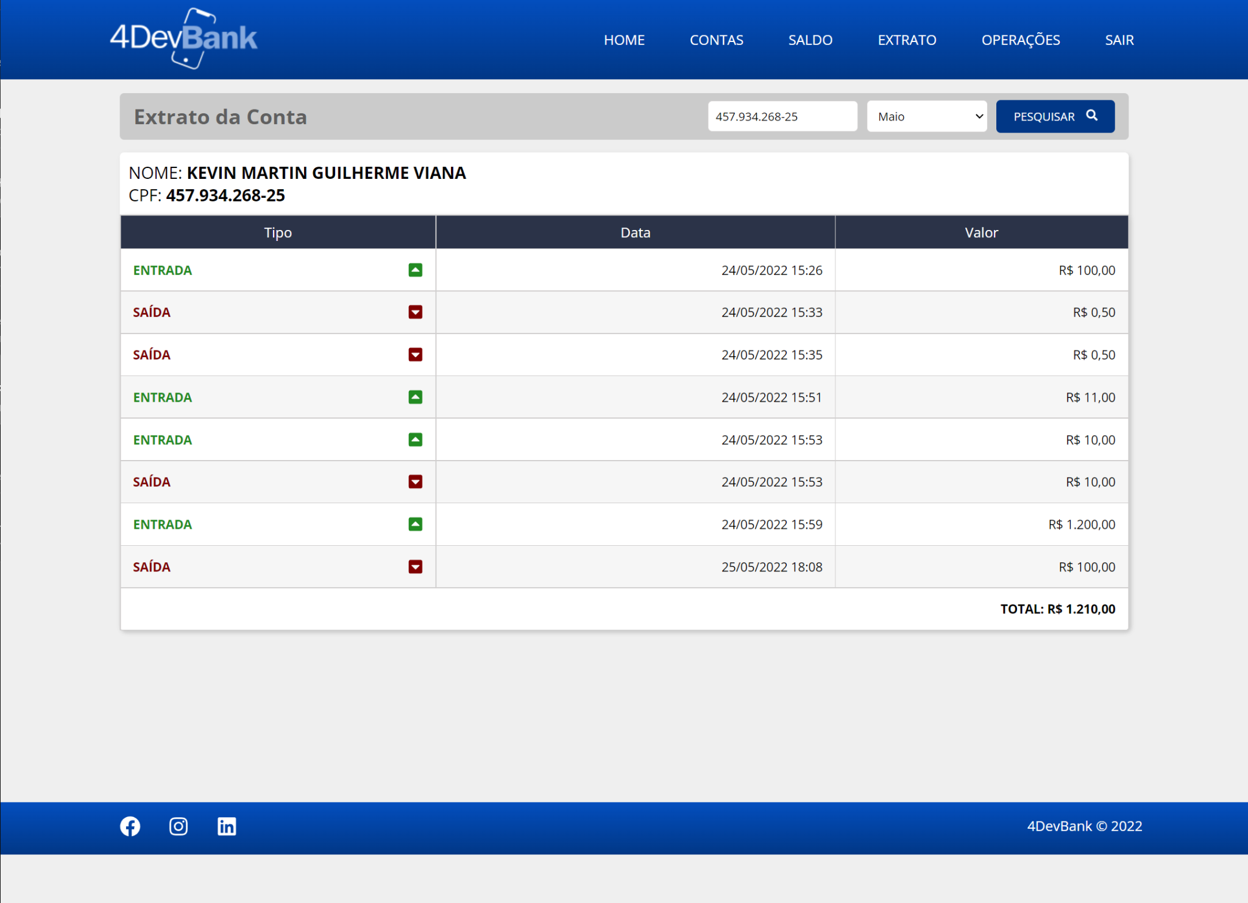
/EXTRATO
4DEVBANK
trade4Dev.jsx

Slide 11
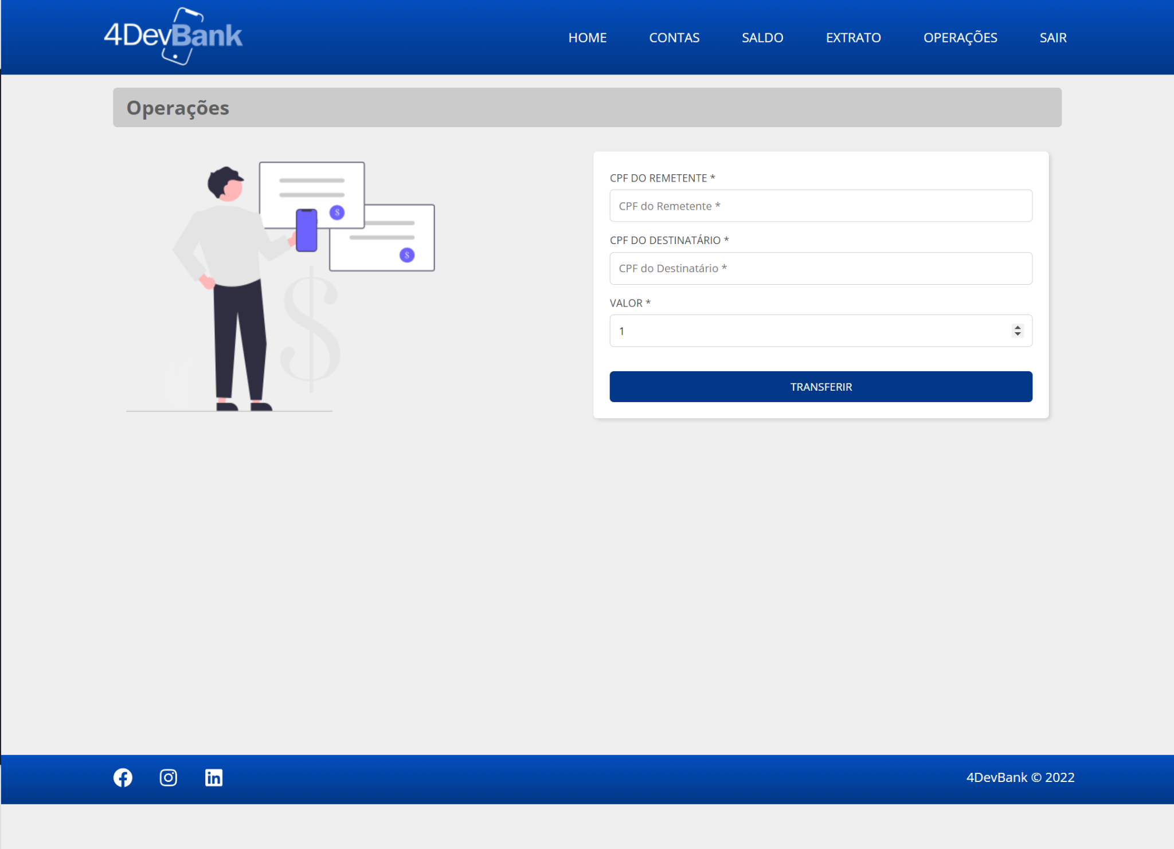
/OPERAÇÕES
4DEVBANK
trade4Dev.jsx

Slide 12
4DEVBANK
/OBRIGADO
/PERGUNTAS_?
trade4Dev.jsx

